Slide 1
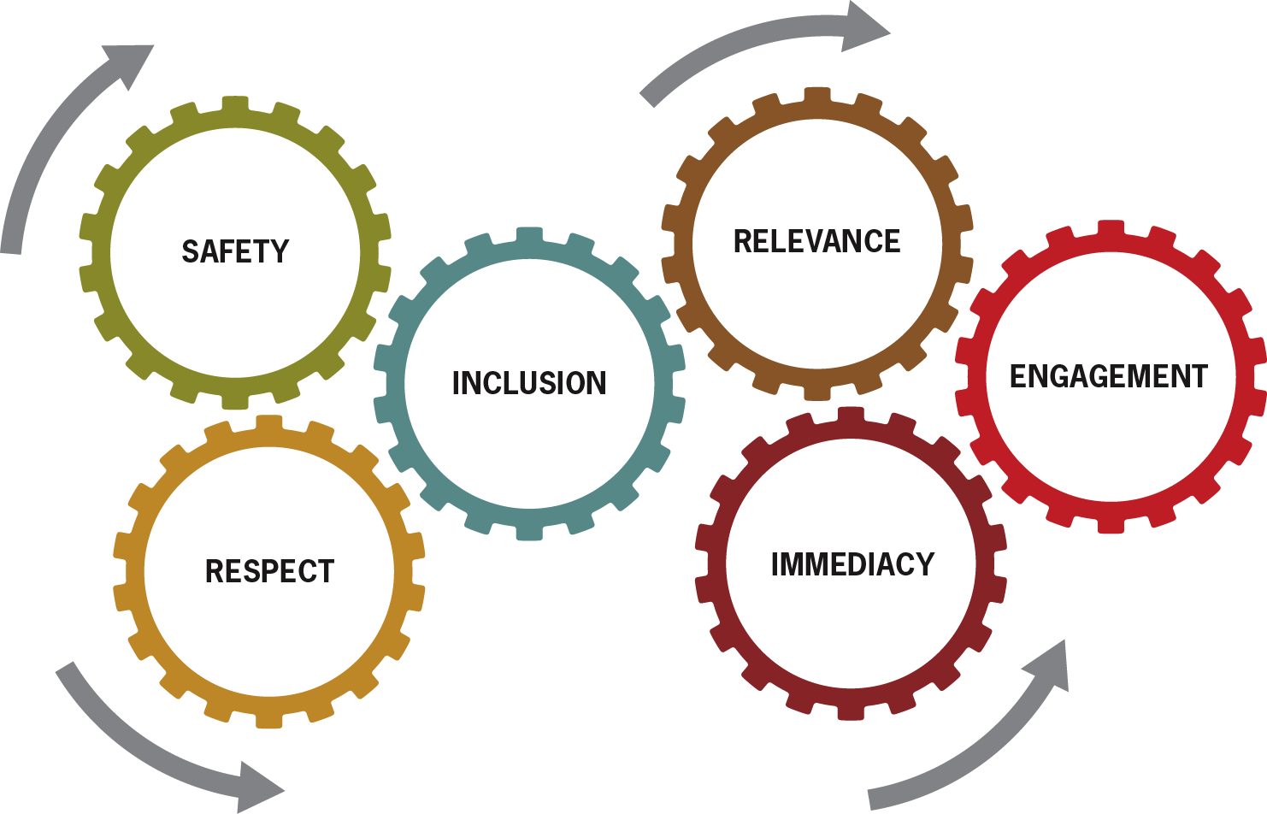
Lunch & Learn:
On Being Learning Centered as Our Organization
Sharing Learning of
Foundations of Dialogue Education
Notes:
Welcome and thanks for coming today!

Slide 2
Our Organization as a Place of Learning
Sharing Learning of
Foundations of Dialogue Education
Notes:
Welcome and thanks for coming today to our session here at our corporate retreat.

Slide 3


Warm Up: Our Organization as a Place of Learning
Notes:
Facilitator Notes:
Learning abounds in our organization and includes both formal and informal situations! Some examples might include team meetings and performance evaluations, but there are many other ways.

Slide 4

Jot down all of the many situations where:
  learning already happens here
  we would like to see learning happen.
Notes:
Facilitator Notes:
Take two minutes to jot down all of the many learning situations which you have influence over in your work where learning already happens, or where we would like to see learning happen.

Slide 5
Share your ideas with a partner.
Notes:
Facilitator Notes:
Share your ideas with a partner.

Slide 6
Six Core Principles for Learning
Notes:
Facilitator Notes:
As you listen to a presentation about the 6 core principles, think about ways in which you have seen these honored and practiced in this organization (or not!). What was the impact of the presence or absence of these principles?
1. What comes to mind when you see these cogs as connected and interconnecting in this way?
2. Which of these is especially important to you as a participant in an event, meeting or this organization?

Slide 7


Safety
Jane Vella Clinical Research
Start with quiet reflection and/or a pair share on the topic, before asking participants to share aloud in the whole group.
Ensure I feel safe enough to participate, learn and be myself.
Notes:
Safety
Adults will not learn if the environment feels threatening. The perception of threat can trigger physiological changes in the brain that reduce its capacity for deep thinking. The atmosphere in the room, the design of learning tasks, the way dialogue is structured and facilitated should create an increasing sense of safety, so that adults can take increasing levels of risk with their learning.
Putting it into Practice
Affirm learner’s ideas, questions and (even) resistance.
Be transparent about why and how the workshop is running.
Use warm-ups at the beginning of each day of a workshop to build safety and respect in a group.
Be attentive to power dynamics in the group.

Slide 8

Inclusion
Jane Vella Clinical Research
Provide varied opportunities for everyone’s voice to be heard by someone, either in pairs, small groups, or the whole group.
Invite me in
and hear
my voice!
Notes:
Inclusion
Adults need to feel and be included in the learning process, to see that their perspective matters, and to trust that their voice is invited and heard. Facilitators must be sensitive to how the dynamics of gender, age, physical ability, education, culture, religion, ethnicity and community position (e.g. power) influence participation in any given event. They should watch for the balance of voices and perspectives raised in the group and design and facilitate in ways that intentionally draw on the
varied expertise and experience in the room.
Putting it into Practice
Establish clear ground rules for the event.
Intervene with a participant who tends to dominate the discussion, or shut down other participants.
Use small group and pair work to ensure all voices are raised and heard.
In situations where there is a known imbalance of power, less large group work is recommended.

Slide 9

Engagement
Jane Vella Clinical Research
Design to allow everyone to try out what is being taught in familiar ways of their choosing (e.g. writing, drawing, demonstration).
Fully engage me as an active partner.
Notes:
Engagement
Adults learn when they are fully and actively engaged in the process of learning, not when they are passive recipients of someone else’s learning. This active engagement involves their intellect, their feelings and their physical actions. This may be a noisy process (they are talking), a quiet process (they are thinking, or wrestling with it), or an active process (they are searching, practicing, doing).
Putting it into Practice
Always give learners time to personalize and do something with new content.
Use individual, pair, and small group work to ensure everyone is engaged.
Keep presentations short, and appropriately “chunked” so they spend less time hearing and more time doing.

Slide 10
Respect
Malcomb Knowles Formal Research
Ask learners to share past experience or knowledge they have on the topic. Build on what they already know when adding new ideas and content.
Acknowledge & affirm who I am
and what I bring.
Notes:
Learning is risky for adults, and they need feel respected in order to take that risk. Facilitators demonstrate respect when they acknowledge and use the wealth of experience and knowledge that adults bring to a learning environment, when they affirm that the adult learners are the key decision-makers in their own learning process, when they present content in ways that invite critical analysis, input, and ideas for personal application.
(show slide notes now… animate each one in)
Putting it into Practice
Don’t do or decide what learners can do or decide for themselves.
Invite learners to add their experience, examples and knowledge to new content.
Invite participation rather than calling on people by name.
Avoid activities that embarrass people.

Slide 11

Relevance
Malcomb Knowles Formal Research
Create space for participants to reflect on how the content and the new learning is relevant to their work and world.
Connect the content with my daily life and context.
Notes:
Relevance
Adults must see a reason for learning new content or they will “unhook” and disengage in the learning process. Good teaching connects new content with learner’s daily lives and real needs. Learners will learn faster and more permanently that which is significant to them and their present lives.
Putting it into Practice
Discover what your learners want and need BEFORE the event. Invite their input
Use stories and examples related to their context.
Invite them to personalize the content. Ask them to relate it to their work and life.
Avoid creating sessions where the content will be relevant for only one part of the group.
Most students don’t voice this question, but … [each] has the right to wonder: Why should I devote my precious time to learning your subject? —Teaching with your Mouth Shut, Donald L. Finkel.

Slide 12
Immediacy
Malcomb Knowles Formal Research
Invite learners to tell one thing they would especially like to learn more about relative to the objectives or content of the course.
Discover & apply this to my immediate needs.
Notes:
Immediacy
Adults are more engaged when they see the immediate usefulness of what they are learning. If they will be using something very soon, they will work harder to learn it. Facilitators can build immediacy by helping participants to discover opportunities for immediate application, and by building opportunities for immediate application into the session.
Putting it into Practice
Ask participants to visualize and describe when and where they will apply it in the near future— “How do you see yourself using this in the next week?”
Invite them to create action plans to put the new skill into practice.
Build practice, cases or demonstrations into the session so that learners know they will be applying it very shortly.

Slide 13
Six Core Principles for Learning
Notes:
Facilitator Notes:
As you listen to a presentation about the 6 core principles, think about ways in which you have seen these honored and practiced in this organization (or not!). What was the impact of the presence or absence of these principles?
What comes to mind when you see these cogs as connected and interconnecting in this way?
Which of these is especially important to you as a participant in an event, meeting or this organization?

Slide 14
1 Principle
1
Safety
Inclusion
Engagement
Respect
Relevance
Immediacy
Notes:
Facilitator Notes:
Take a silent minute to think about which one of these principles you most want to focus on in your work in the coming month and then walk over to that table/stand under that chart – that’s where you will work for the next while.

Slide 15

Strengthening Core Principles
In Our Work
Notes:
Facilitator Notes:
In your small group, review the short description again of the core principle you have selected to work on.
Share examples you’ve seen inside and outside of this organization of how this has been incorporated/honored really well.
What ideas does this spark about how you can do this in your context?
Write all these ideas on the chart in front of you for others to read.

Slide 16

Strengthening Core Principles
In Our Work
Round 1:
Review the description of your principle on the card.
Share examples of how/where have you seen this principle incorporated really well?
Discuss how you could do this in your context.
Write these ideas on the chart in front of you for others to read.
Notes:
Facilitator Notes:
1. In your small group, review the short description again of the core principle you have selected to work on.
2. Share examples you’ve seen inside and outside of this organization of how this has been incorporated/honored really well.
3. What ideas does this spark about how you can do this in your context? Write all these ideas on the chart in front of you for others to read.

Slide 17

Additional Principles
Round 2: Move to another principle. Read the examples captured by the previous group and Repeat the Round 1 task.
Round 3: Move to another principle and repeat the Round 1 task.
Round 4: Go back to the first principle you worked on. Read what has been added. What else comes to mind? Add those, to your chart also.
Notes:
Facilitator Notes:
Round 2: Move to another principle that you are interested in and do same thing, starting with silently reading the examples already captured by the previous group.
Round 3: Move to another principle and repeat.
Round 4: Go back to first principle you worked on and read what has been added. What else comes to mind for you at this time? Add that too.

Slide 18

2 Things to Do Right Away
Walk to all tables – do a gallery walk.
Select 2 things you will do right away in your work.
Write them in the box that looks like this one.
Share your ideas with the whole group at the end.
1
2
Notes:
Facilitator Notes:
On your own, walk around to all the tables and select 2 things you want to do right away in your work. Write those below and we will share your ideas at the end.

Slide 19
2 Things to Do Right Away
1
2
Notes:
Facilitator Notes:
On your own, walk around to all the tables and select 2 things you want to do right away in your work. Write those below and we will share your ideas at the end.

Slide 20

Share 1 idea to offer your organizational leadership
Notes:
Facilitator Notes:
Now, select 1 idea you want to offer leadership, with the idea to create a “learning organization”.
Write this on a Post-it note and we will collect them at the end.

Slide 21

So now what?
Notes:
Facilitator Notes:
Let’s hear some examples from those wanting to share.
What principle do you want to work on? What one action step will you take to further honor this in your work?

Slide 22
Examples of impact when achieved!
Notes:
Facilitator Notes:
We will now collect all your ideas for the organization.
As we reflect on what impact all this positive action would mean, think of 1 or 2 words that summarize the potential impact WHEN you DO these.
Let’s call out those words as way to end our time together.
Thank you for your participation!

Slide 23
Six Core Principles for Learning
Call out one thing you see yourself doing differently
in regards to being more learning-centered at work.
Notes:
Facilitator Notes:
As you listen to a presentation about the 6 core principles, think of ways in which you have seen these honored and practiced in this organization (or not!). What was the impact of the presence or absence of these principles?
What comes to mind when you see these principles as connected and interconnecting in this way?
Which of these principles is especially important to you as a participant in an event, meeting or this organization?

Slide 24

Resources

Slide 25
BLOG
Notes:
This is the blog

Slide 26
Resources

